Slide 1

DRUG RECOMMENDATION SYSTEM
DOMAIN – MACHINE LEARNING
TEAM MEMBERS
SRI HEMA N - 20EUAI040
SURYA M R - 20EUAI044
GUIDE
Dr. T. SUJATHA
ASSOCIATE PROFESSOR
DEPARTMENT OF AI&DS

Slide 2
ABSTRACT
The development of day-to-day modern environment food that causes various types of diseases. The disease recovering stage needs prolonged treatment which demands various drugs based on the patient’s health condition. The main problem is the drug recommendation and the drug compound molecules that are not relational to curing diseases that lead to side effects. To improve the performance of drug recommendations based on a machine learning approach Decision Tree Classification is used for analyzing the success rate of drug recommendations.This system can accurately recommend drugs with high potential utility, and the predicted drugs can be administered in tablet form to aid in disease recovery. The model outperforms previous models and has the potential to be a valuable tool in drug recommendations..

Slide 3
PROBLEM STATEMENT
The ability of the recommendation system should be able to process the data provided by the patient analyze it and make a decision based on the entities of the data. The main challenge is to develop an accurate and efficient algorithm that can classify patients into different groups based on their medical history, symptoms and other relevant data.
The system should be able to recommend the most suitable drug for a patient based on the results of the classification algorithm. The inability to classify patients correctly made it challenging to recommend the most suitable drug for a patient.

Slide 4
EXISTING SOLUTION
Many open drug recommendations need to take more features on data analysis, don’t consider the molecules-oriented features,and provide a big quantity of possessions for direct screening which leads to classification failures.
The existing classification algorithm aims to provide efficient drug recommendations that 94% of prediction results for drug recommendations.
This approach can be time-consuming and may not result in the best treatment outcome for the patient.

Slide 5
DISADVANTAGE OF EXISTING SYSTEM
The accuracy and effectiveness of the system depend on the quality of patient data used to train the machine learning model.
Incomplete or inaccurate data can lead to incorrect medication recommendations.
The system's recommendations are based solely on the available data and may not account for other factors that may impact a patient's response to the drug, such as genetic variations, lifestyle factors, or environmental factors.

Slide 6
PROPOSED SYSTEM
The proposed system uses machine learning algorithms to analyze patient data and recommend the most suitable medication.
The system is trained on a dataset of patients who suffered from the same illness and responded to one of five medications Drug A , B, C, X and Y
The system uses a decision tree to predict the appropriate medication for a new patient based on their age, gender, cholesterol level, blood pressure level, and sodium to potassium value.

Slide 7
ADVANTAGE OF EXISTING SYSTEM
The proposed system can provide personalized medication recommendations based on individual patient data, which can improve the accuracy and effectiveness of treatment.
The system uses machine learning algorithms to analyze patient data and make recommendations, which can save healthcare providers time and resources in the decision-making process.
The system can be easily scaled up to handle large volumes of patient data, making it suitable for use in a variety of healthcare settings.

Slide 8
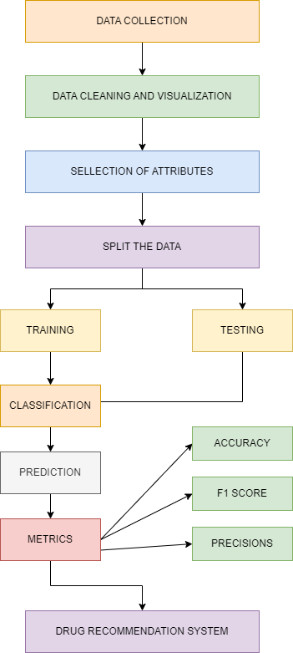
PROPOSED SYSTEM ARCHITECTURE

Slide 9
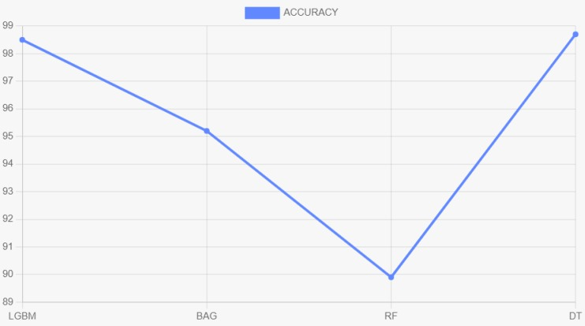
ACCURACY FOR THE PROPOSED SYSTEM

Slide 10
LITERATURE SURVEY
Leilei Sun examined large scale treatment records to locate the best treatment prescription for patients. The idea was to use an efficient semantic clustering algorithm estimating Naive Bayes and Recurrent Neural Network (RNN). The results exhibit that RNN with 95.34% outperformed Naive Bayes, 77.21%.
Jiugang Li et al constructed a hashtag recommender framework that utilizes the skip-gram model and applied convolutional neural networks (CNN) to learn semantic sentence vectors. These vectors use the features to classify hashtags using LSTM RNN. Results depict that this model beats the conventional models like SVM, Standard RNN. This exploration depends on the fact that it was undergoing regular AI methods like SVM and collaborative filtering techniques; the semantic features get lost, which has a vital influence in getting a decent expectation.

Slide 11
TECHNOLOGIES USED
Python
Framework
Flask
Front End
HTML CSS
Deployment
VS code

Slide 12
REFERENCES
[1]Leilei Sun, Chuanren Liu, Chonghui Guo, Hui Xiong, and Yanming Xie. 2016. Data-driven Automatic Treatment Regimen Development and Recommendation. In Proceedings of the 22nd ACM SIGKDD International Conference on Knowledge Discovery and Data Mining (KDD ’16). Association for Computing Machinery, New York, NY, USA, 1865–1874. DOI:https://doi.org/10.1145/2939672.2939866
[2] Jiugang Li et al ,Irene Luque Ruiz, Miguel Ángel Gómez-Nieto, Building highly reliable quantita- tive structure-activity relationship classification models using the rivality index neighborhood algorithm with feature selection, J. Chem. Inf. Model. 60 (1) (2020) 133–151, https://doi.org/10.1021/acs.jcim.9b00706.
IEEE PAPER:
https://www.sciencedirect.com/science/article/pii/S2772528622000218#!

Slide 13
CONCLUSION
In conclusion, the proposed model based on Decision Tree Classification has produced a better feature selection process and a successful compound analysis model to predict the correct compound molecules. The drug recommendation system using machine learning was able to accurately predict the appropriate drug compound for patients with tablets. The proposed system has produced higher performance upto 98.7% and makes the best compound analysis model for drug recommendation .

Slide 14
FUTURE SCOPE
The current system uses a limited set of patient attributes to make drug recommendations. Future work could explore the incorporation of additional patient data such as genetics, medical history and lifestyle factors to improve the accuracy of the recommendations. The system uses a decision tree algorithm to make drug recommendations. In Future it could be explore the use of more advanced machine learning algorithms such as neural networks, support vector machines, or other algorithms, which may be able to better capture the complexity of the patient data along with the diet plan and dosage of the medicine.

Slide 15
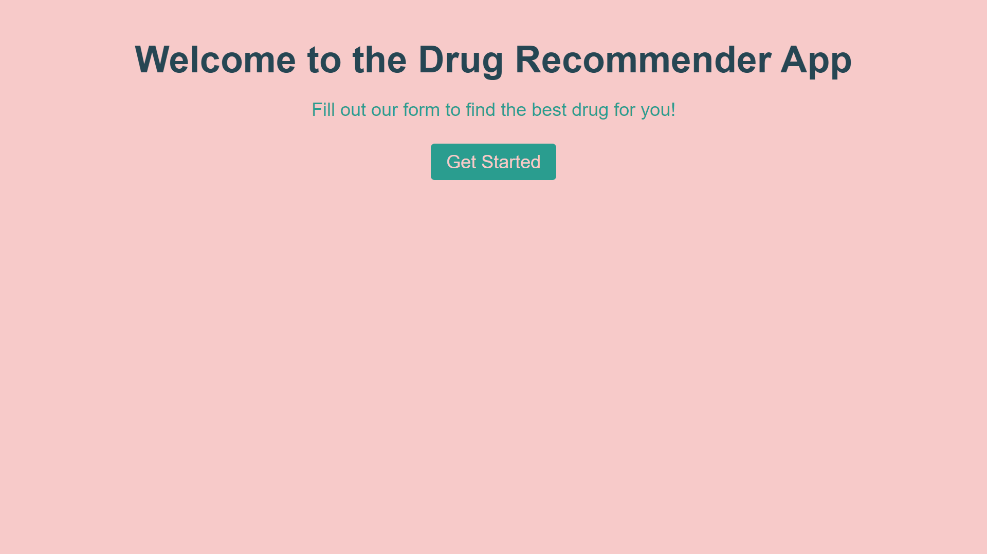
APPENDIX

Slide 16
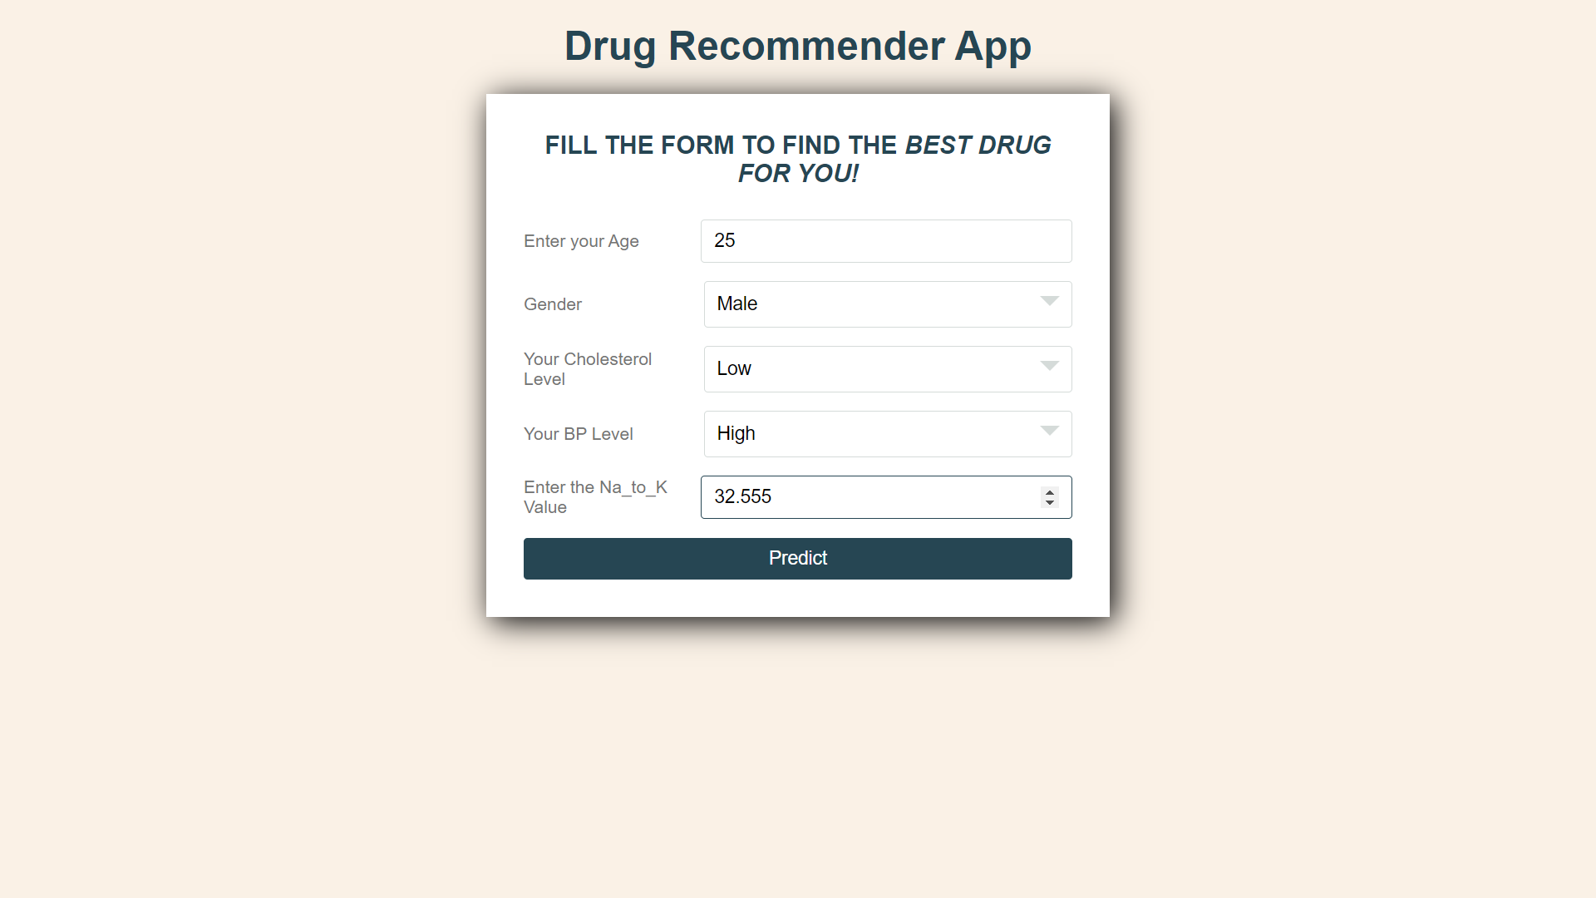

Slide 17
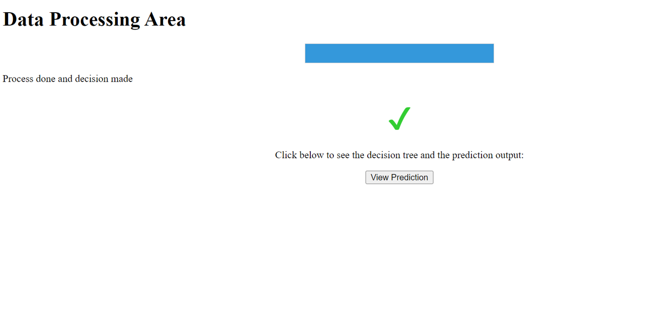

Slide 18
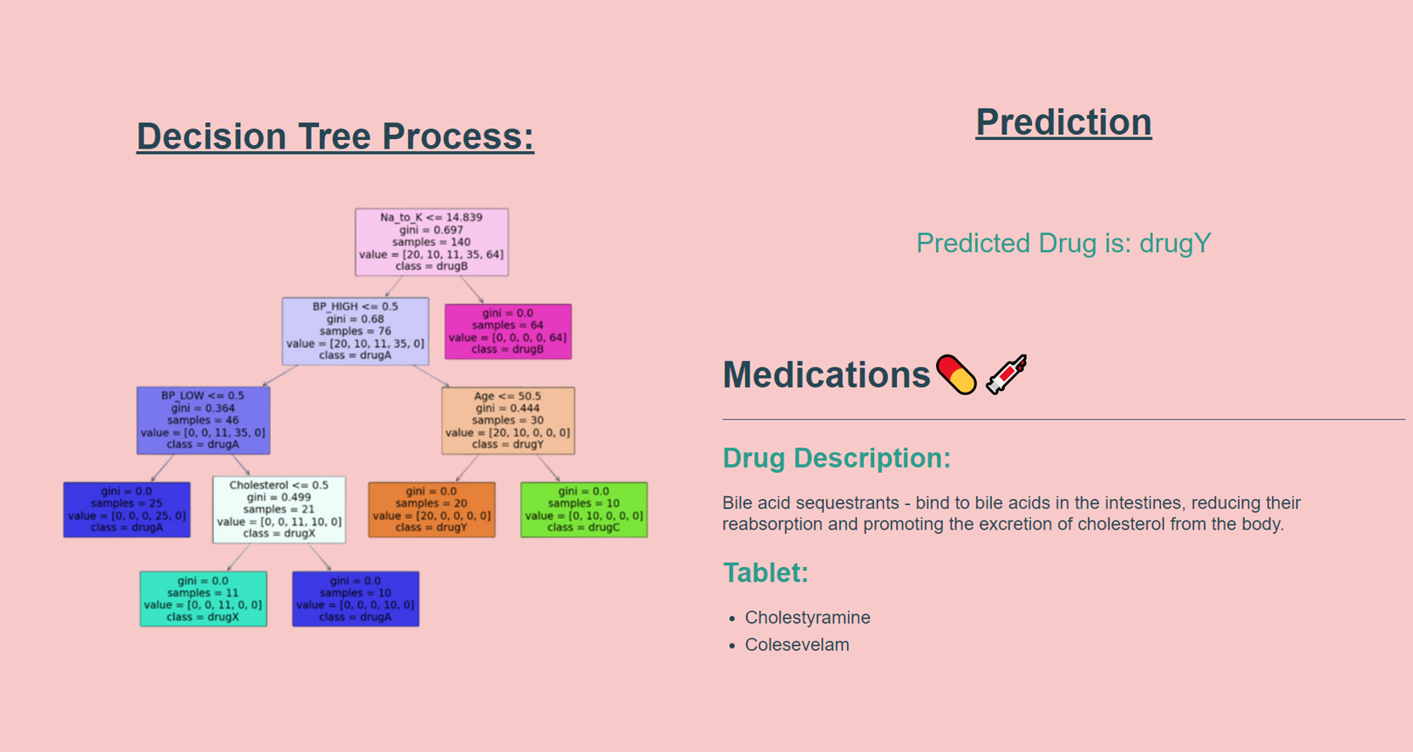

Slide 19
QUERIES

Slide 20
THANK YOU!

